Slide 1
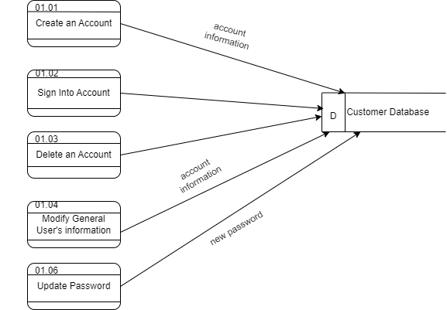
Revolution Art Data Flow Diagram(Physical)

Slide 2
Revolution Art Data Flow Diagram(Logical)
Buyer
Buyer’s Information
01.01 Create an Account
Credentials
New Password
01.02
Sign into Account
01.03 - 01.04
Manage Account
01.06
Update Password

